Slide 1


<Eduardo Pessina>
<2022-05-24>

Slide 2

Outline
Executive Summary
Introduction
Methodology
Results
Conclusion
Appendix

Slide 3
Executive Summary
Summary of methodologies
I try to use a data driven approach to find and predict whether a particular rocket will successfully re-land after its launch. I try different machine learning models as LogisticRegression, SVC, Decision Tree, KNN and concluded that decision tree best suits for this application as I show you in the results.
Summary of all results
The Decision Tree gave training accuracy of 0.89 while giving a test accuracy of 0.88

Slide 4
Introduction
Project background and context
SpaceX is the first company to reuse the first stage for future launches.
By using the historical data of SpaceX‘s rocket launches I try to find if a future rocket’s first stage can re-land safely using Artificial Intelligence.
The main objective of the Project is to come up with a model that takes in future rocket launches initial data and predicts if it lands safely back to earth. Using this model, I can decide how Much we need to invest in future launches.
Problems you want to find answers
Predicts the success of a future rockets re-landing

Slide 5

Section 1

Slide 6
Methodology
Executive Summary
Data collection methodology:
Perform data wrangling
Perform exploratory data analysis (EDA) using visualization and SQL
Perform interactive visual analytics using Folium and Plotly Dash
Perform predictive analysis using classification models

Slide 7
Data Collection
This is the main phase in any Data Science task.
We used two approaches for the data collection.
Input : spacex-api-data-collection.ipynb :
https://github.com/eduofpess/ibm/blob/main/spacex-api-data-collection.ipynb
2. Input : webscraping_pages.ipynb :
https://github.com/eduofpess/ibm/blob/main/webscraping_pages.ipynb
3. Output : Raw Data
spaceX-api
spaceX-api
Wildpedia pages

Slide 8
Data Collection – SpaceX API
SpaceX’s API : collect booster versions, payload, core and launch site (payload id, launch id as parameters for my API)
spacex-api-data-collection.ipynb:
https://github.com/eduofpess/ibm/blob/main/spacex-api-data-collection.ipynb
getBoosterVersion()
getLounchSite()
spaceX-API
Raw Data
getPayloadData()
getCoreData()

Slide 9
Data Collection - Scraping
Wikipedia tables to collect some data abaou SpaceX’s previous lanches
webscraping_pages.ipynb :
https://github.com/eduofpess/ibm/blob/main/webscraping_pages.ipynb
requests
Wikipedia
BeautifulSoup
Raw Data

Slide 10
Data Wrangling
ETL data to machine readable;
Missing data in PayloadMass column and replace with mean();
Replaced (false,none) in landing_outcomes to (0,1)
data-wrangling.ipynb:
https://github.com/eduofpess/ibm/blob/main/data-wrangling.ipynb

Slide 11
EDA with Data Visualization
I use those plots to analyse the data
Bar chart to find success rate fo different orbits;
Scatter plot of flight_numbers, launch_site and payload in orbit;
Line plot for yearly success rate of total launches;
Cat plot of flight_numbers, payload mass;
eda-data_visualization.ipynb:
https://github.com/eduofpess/ibm/blob/main/eda-data_visialization.ipynb

Slide 12
EDA with SQL
find unique launch sites:
Select UNIQUE(LAUNCH_SITE) from SPACEXDATASET
print first 5 records with launch site starting with‘CCA’:
Select*fromSPACEXDATASETWHERELAUNCH_SITELIKE‘CCA%’LIMIT5
find avgpayload masscarried by booster F9:
Select AVG(PAYLOAD_MASSKG_) from SPACEXDATASET WHERE BOOSTER_VERSION=‘F9v1.1’
…
eda-sql.ipynb :
https://github.com/eduofpess/ibm/blob/main/eda-sql.ipynb

Slide 13
Build an Interactive Map with Folium
Plotted launch sites available in our dataset based on lat, long;
Used markers_cluster to mark ass success/failed launces in each site;
Find the distance of those sites from cities, sea shores , …
Find if a launch be successful based on their proximities
interative_map_folium.ipynb:
https://github.com/eduofpess/ibm/blob/main/interative_map_folium.ipynb

Slide 14
Build a Dashboard with Plotly Dash
Based on launch site and payload mass;
Plotted a pie chart of success rate on launch site;
Plotted scatter plot payload effects th success rate of a launch
dash.ipynb:
https://github.com/eduofpess/ibm/blob/main/dash.ipynb

Slide 15
Predictive Analysis (Classification)
logistic regression,SVC,DecisionTree,KNNasourmodels;
Load the data, perform some standardization.
Divide data in trainn and test sets.
Use training set to iteratively find the best parameters for that data and finalized the parameters.
Find the best model of the four modes based on test set performance.
classification-predictive_analysis.ipynb:
https://github.com/eduofpess/ibm/blob/main/classification-predictive_analysis.ipynb
https://github.com/eduofpess/ibm/blob/main/prediction.ipynb

Slide 16
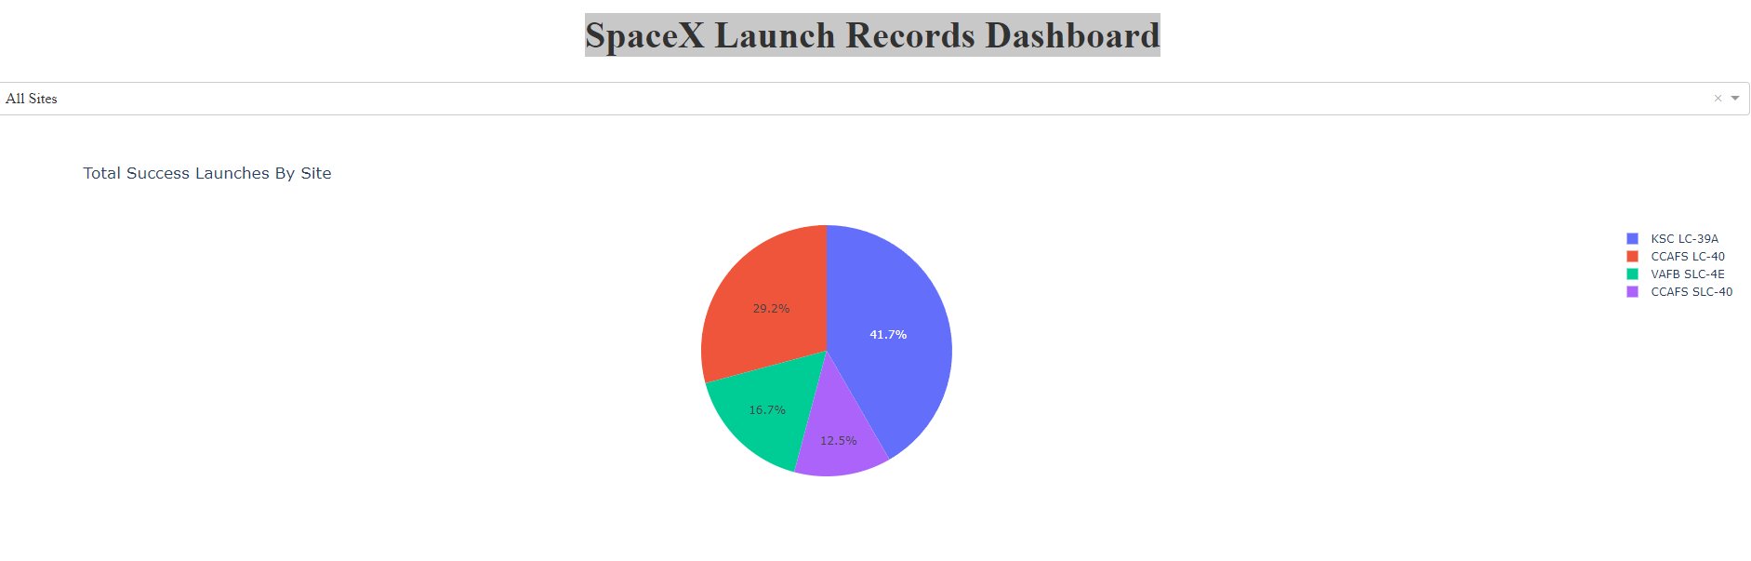
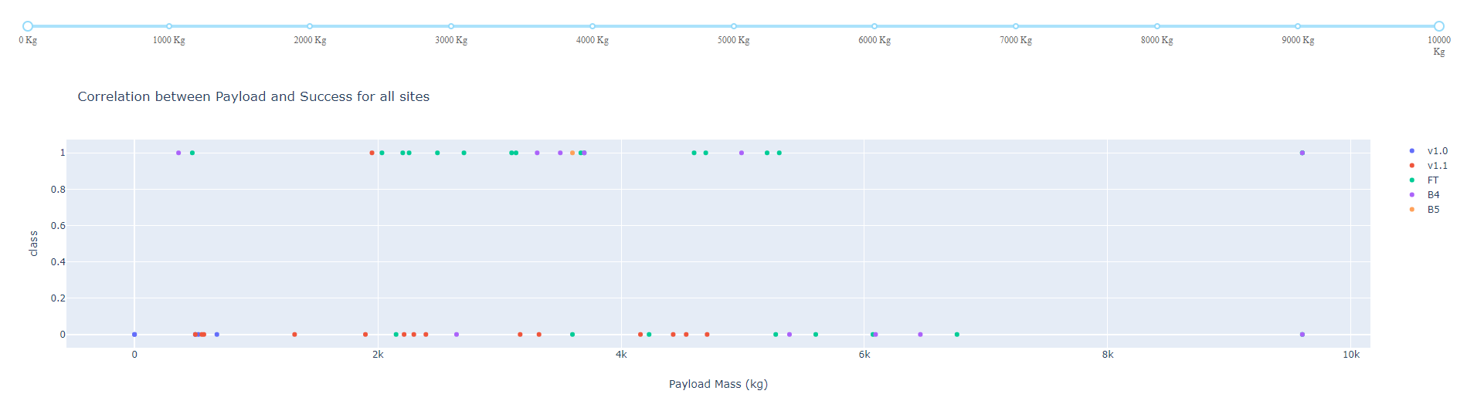
Results
Exploratory data analysis results
2013 there is significant increase in the success rate;
There is 99% of successful mission outcome;
KSCLC-39A launch site has highest successful landing rate.
Interactive analytics demo in screenshots
Predictive analysis results
Decision Tree 0.88
Logistic regression 0.83
SVM 0.83
KNN 0.83
https://github.com/eduofpess/ibm/blob/main/prediction.ipynb

Slide 17

Section 2

Slide 18
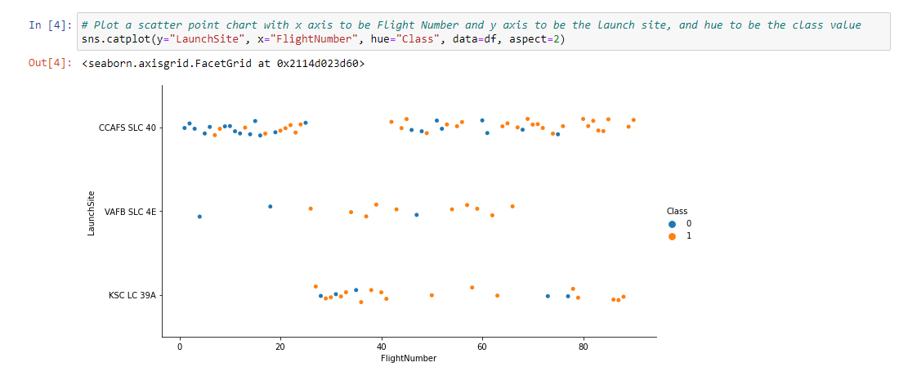
Flight Number vs. Launch Site
We see that different launch sites have different success rates. CCAFS LC-40, has a success rate of 60 %, while KSC LC-39A and VAFB SLC 4E has a success rate of 77%.

Slide 19
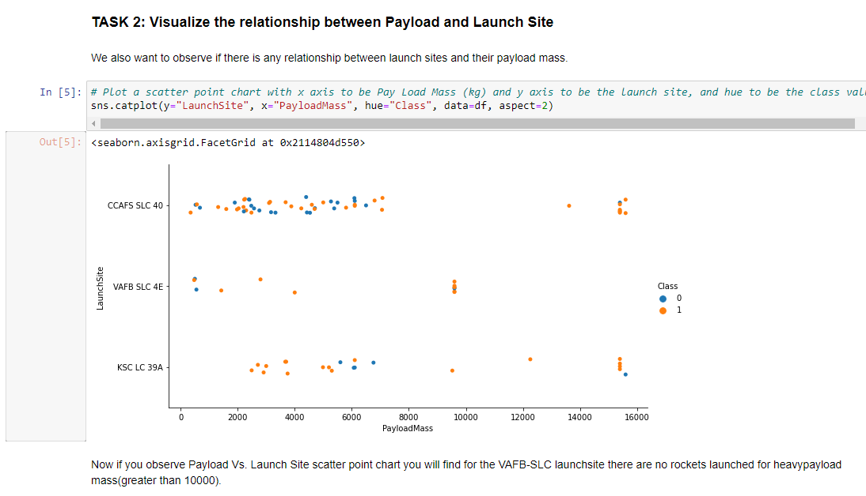
Payload vs. Launch Site
Payload Sucess Rate
Less 8000 kg +- 50%
More 8000 kg +- 100%

Slide 20
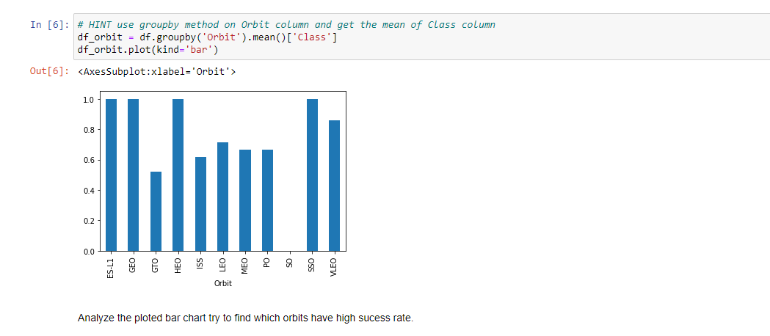
Success Rate vs. Orbit Type
SO problem
GTO , LEO, Pom GTO – some problem
Others no problem at all

Slide 21
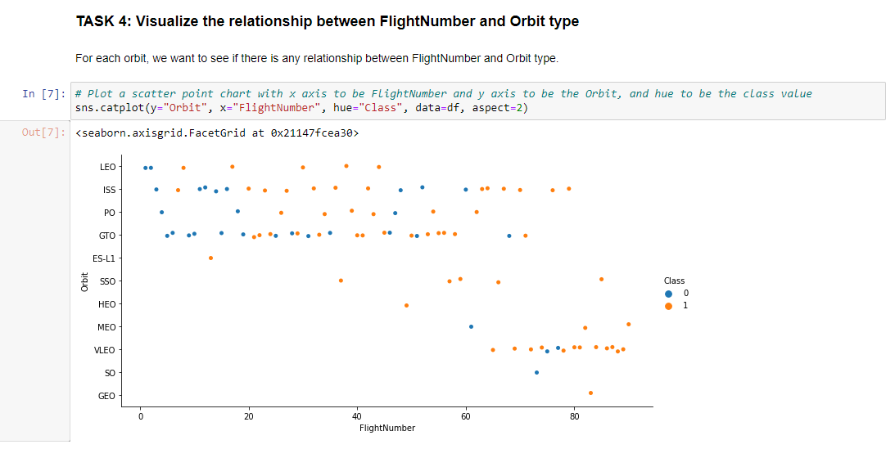
Flight Number vs. Orbit Type
Above 80 are all successful

Slide 22
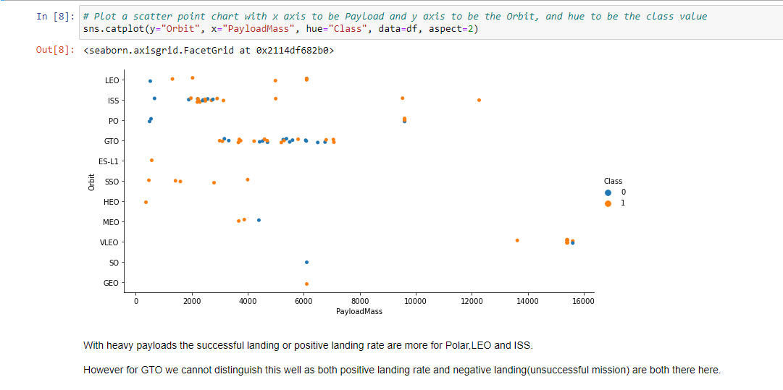
Payload vs. Orbit Type
LEO above 2000kg are 100% sccessful;
SSO 100% successful

Slide 23
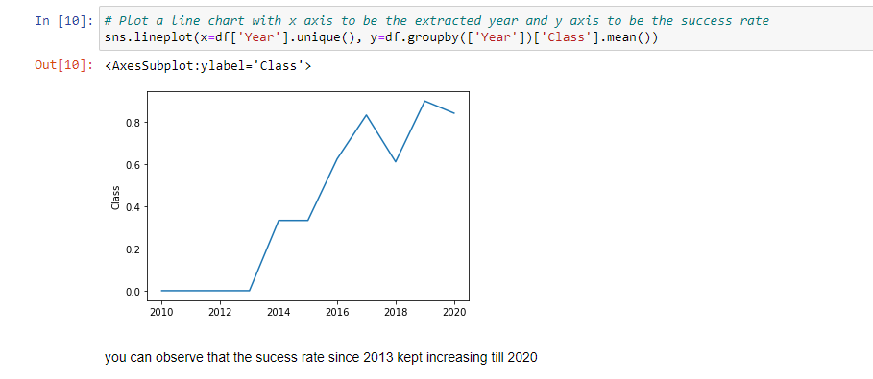
Launch Success Yearly Trend
After 2018 highest success rate are achieve

Slide 24
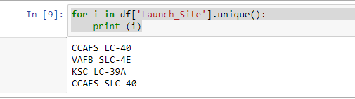
All Launch Site Names
Query : Select UNIQUE (LAUNCH_SITE) from SPACEXDATASET
Pandas :

Slide 25
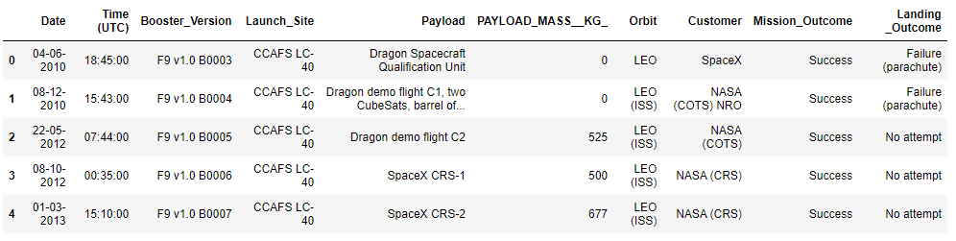
Launch Site Names Begin with 'CCA'
Find 5 records where launch sites begin with `CCA`
Query : Select * from SPACEXDATASET WHERE LAUNCH_SITE LIKE ‘CCA%’ LIMIT5
Pandas : df[df.Launch_Site.str.contains('CCA',case=True)][:5]

Slide 26
Total Payload Mass
Calculate the total payload carried by boosters from NASA
Query : Select MAX(PAYLOAD_MASSKG_) from SPACEXDATASET WHERE CUSTOMER=‘NASA(CRS)
Pandas : df[df.Customer=='NASA (CRS)'].PAYLOAD_MASS__KG_.max()

Slide 27
Average Payload Mass by F9 v1.1
Calculate the average payload mass carried by booster version F9 v1.1
Query : SELECT AVG(PAYLOAD_MASS_KG_) FROM SPACEXDATASET WHERE BOOSTER_VERSION=‘F9 v1.1’
Pandas :df[df.Booster_Version==‘F9 v1.1’].PAYLOAD_MASS__KG_.mean()

Slide 28
First Successful Ground Landing Date
Find the dates of the first successful landing outcome on ground pad
QUERY : SELECT MIN(DATE) FROM SPACEXDATASET WHERE LANDING_OUTCOME= ‘Success (ground pad)’
Pandas : df[df["Landing _Outcome"]=='Success (ground pad)'].Date.min()

Slide 29
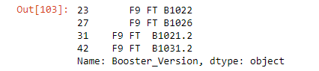
Successful Drone Ship Landing with Payload between 4000 and 6000
List the names of boosters which have successfully landed on drone ship and had payload mass greater than 4000 but less than 6000
Query : SELECT BOOSTER_VERSION FROM SPACEXDATASET WHERE LANDING_OUTCOME= ‘Success (drone ship)’ and PAYLOAD_MASS_KG_>4000 AND PAYLOAD_MASS_KG_<6000
PANDAS :
df1 = df[df["Landing _Outcome"]=='Success (drone ship)']
df1[(df1.PAYLOAD_MASS__KG_ >4000) & (df1.PAYLOAD_MASS__KG_ <6000)].Booster_Version

Slide 30

Total Number of Successful and Failure Mission Outcomes
Calculate the total number of successful and failure mission outcomes
Query :
Select COUNT(*) from SPACEXDATASET WHERE MISSION OUTCOMELIKE 'Success%’
Select COUNT(*) rom SPACEXDATASET WHERE MISSION_OUTCOMELIKE 'Failure%’
Pandas : df[df.Mission_Outcome.str.contains('Success')==True].Mission_Outcome.count()
df[df.Mission_Outcome.str.contains('Failure')==True].Mission_Outcome.count()

Slide 31
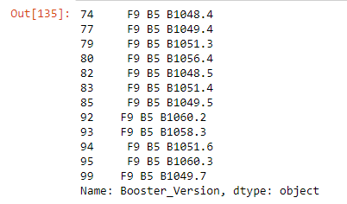
Boosters Carried Maximum Payload
List the names of the booster which have carried the maximum payload mass
Query :
select BOOSTER_VERSION from SPACEXDATASET where PAYLOAD_MASSKG_= (select MAX(PAYLOAD_MASSKG_) from SPACEXDATASET)
Pandas :
df.loc[df['PAYLOAD_MASS__KG_'] == df['PAYLOAD_MASS__KG_'].max()].Booster_Version

Slide 32
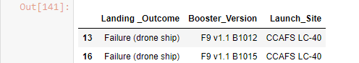
2015 Launch Records
List the failed landing_outcomes in drone ship, their booster versions, and launch site names for in year 2015
Query :
SELECT LANDINGOUTCOME, BOOSTER_VERSION, LAUNCH_SITE from
SPACEXDATASET WHERE LANDINGOUTCOME LIKE 'Failure(droneship)’ and
DATE LIKE '2015%’
Pandas : select = ["Landing _Outcome","Booster_Version", "Launch_Site"]
df[(df["Landing _Outcome"]=='Failure (drone ship)') & (df.Date.str.contains('2015') )][select]

Slide 33
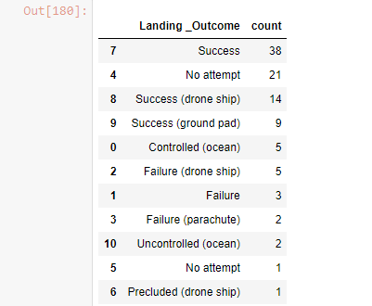
Rank Landing Outcomes Between 2010-06-04 and 2017-03-20
Rank the count of landing outcomes (such as Failure (drone ship) or Success (ground pad)) between the date 2010-06-04 and 2017-03-20, in descending order
Query : select LANDINGOUTCOME , COUNT(LANDINGOUTCOME) as
count from
SPACEXDATASET GROUPBY LANDINGOUTCOME ORDERBY
count DESC
Pandas :df.groupby("Landing _Outcome")["Landing _Outcome"].count().reset_index(name='count’)
.sort_values(['count'], ascending=False)

Slide 34

Section 3

Slide 35
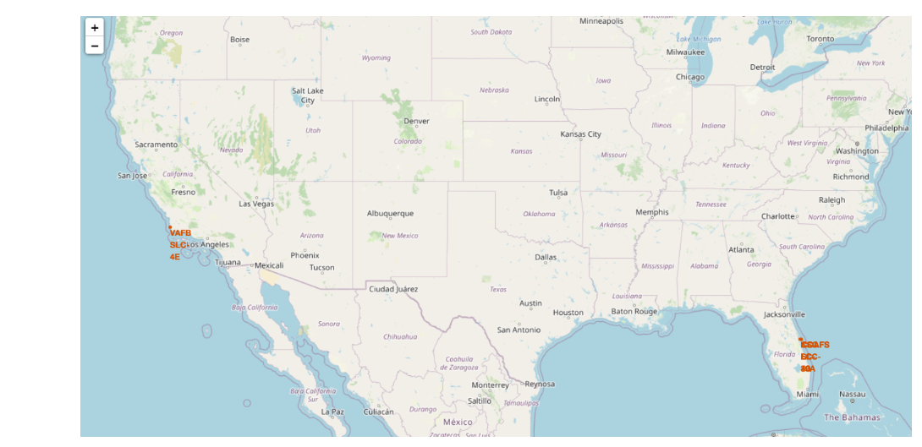
<Launch Sites of SpaceX>
Explore the generated folium map and make a proper screenshot to include all launch sites’ location markers on a global map

Slide 36
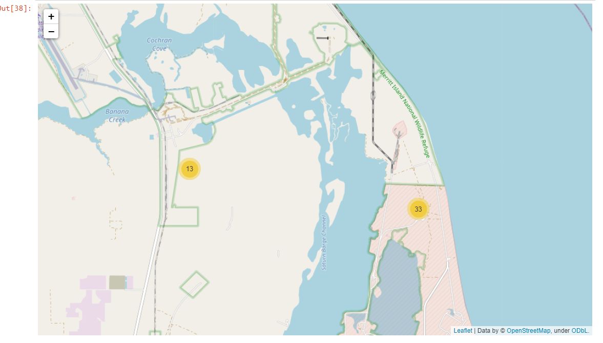
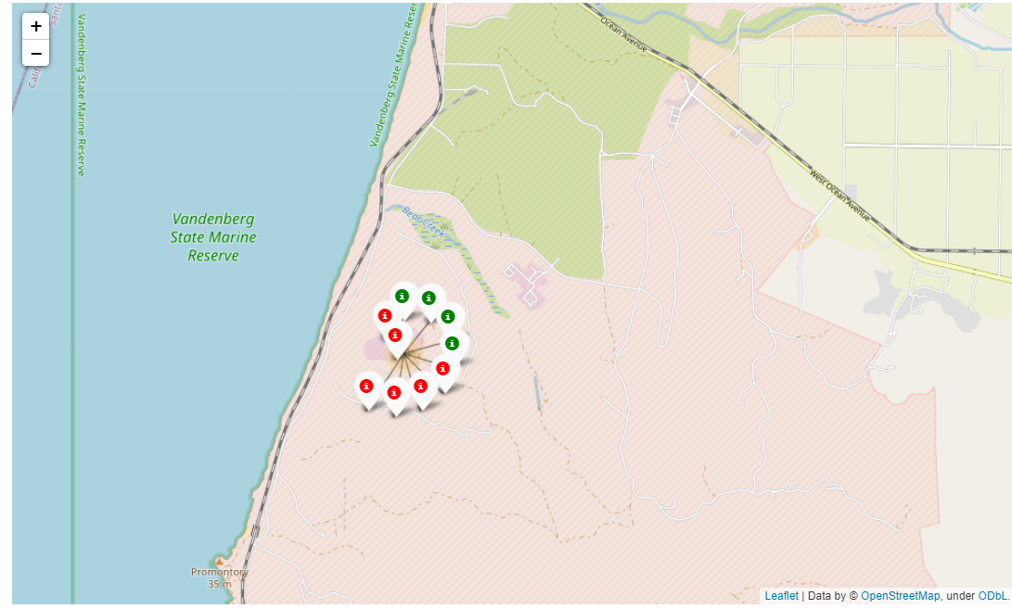
Different Launch Locations Clusters

Slide 37
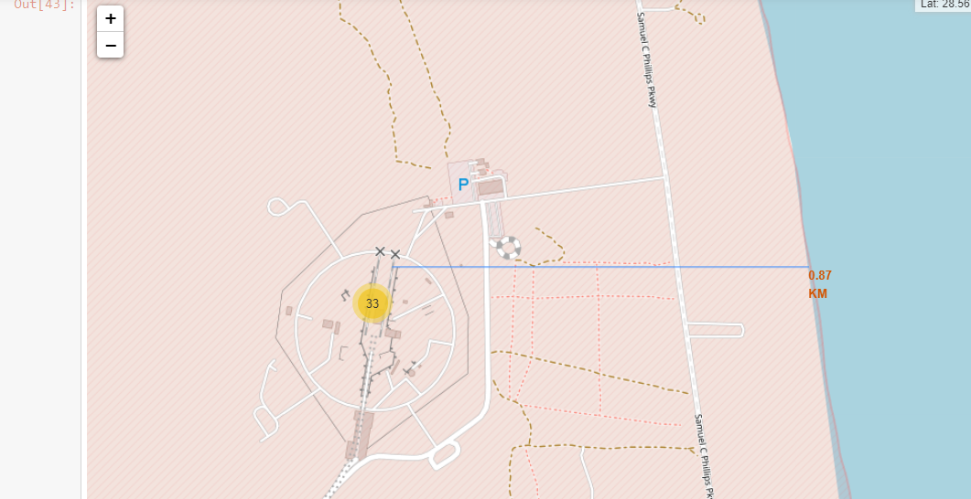
Distance between proximities

Slide 38

Section 4

Slide 39
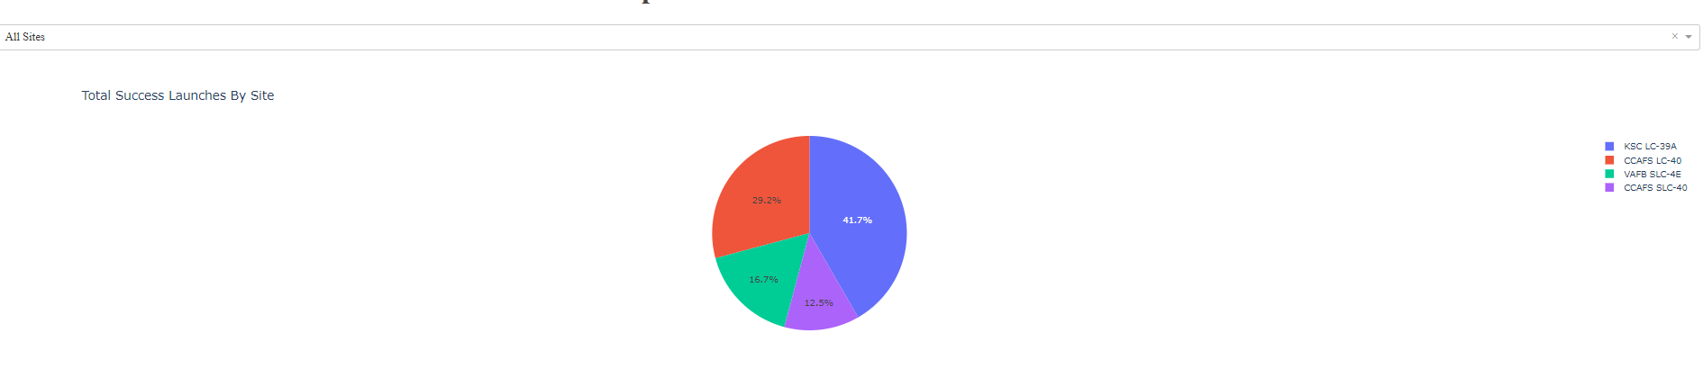
<Pie Chart for all launch sites>

Slide 40
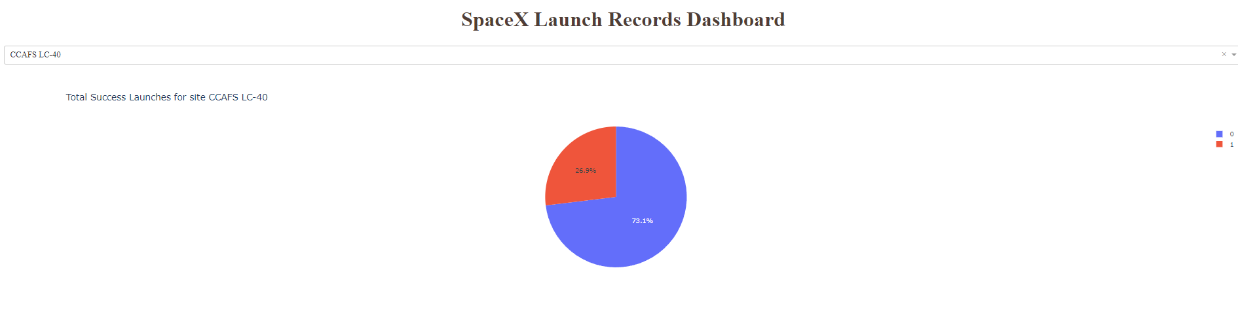
Pie chart with launch site with highest launch success ratio

Slide 41
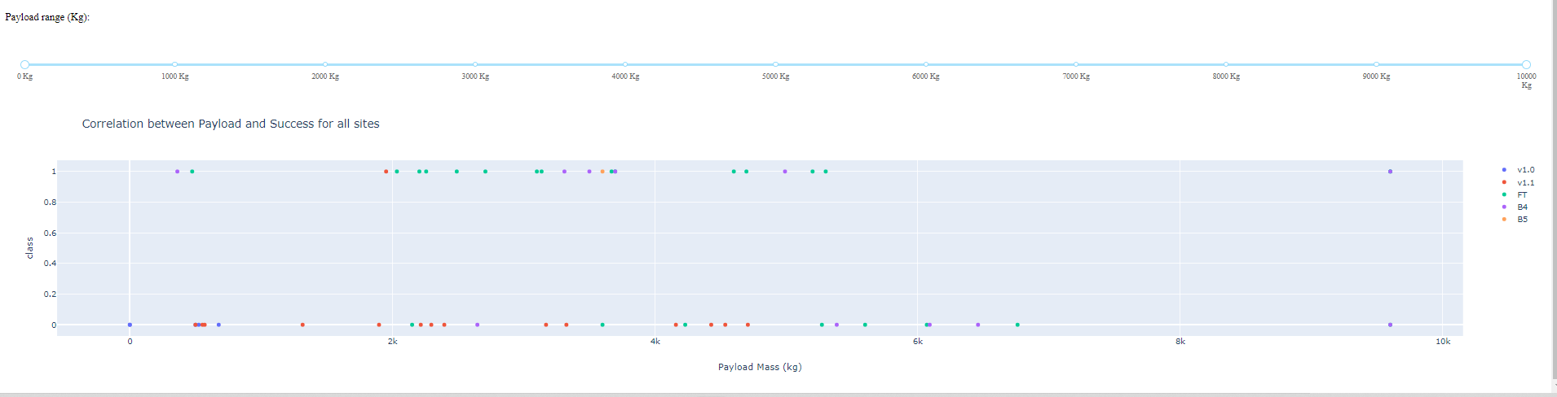
Payload vs. Launch Outcome scatter plot for all sites

Slide 42

Section 5

Slide 43
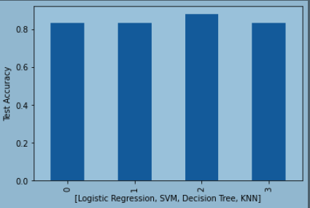
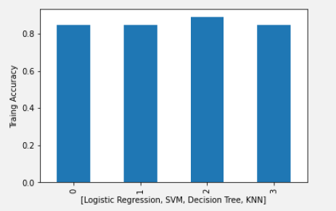
Classification Accuracy
Decision tree has the best accurancy and Test accurancy

Slide 44
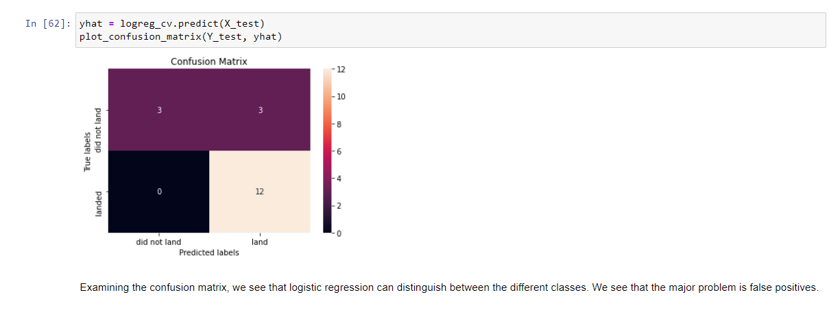
Confusion Matrix
3/ 6 are correctly predicted for negative class and 12/12 are corretly predicted for positive class

Slide 45
Conclusion
Decision tree with gini as criterion, max_deaph of 8, Auto as max features, randopm splitter, min_samples_leaf=4 and min_samples_split = 10 gives the best result

Slide 46
Appendix
https://github.com/eduofpess/ibm/blob/main/Spacex.csv
https://github.com/eduofpess/ibm/blob/main/classification-predictive_analysis.ipynb
https://github.com/eduofpess/ibm/blob/main/dash.ipynb
https://github.com/eduofpess/ibm/blob/main/data-wrangling.ipynb
https://github.com/eduofpess/ibm/blob/main/eda-data_visialization.ipynb
https://github.com/eduofpess/ibm/blob/main/eda-sql.ipynb
https://github.com/eduofpess/ibm/blob/main/interative_map_folium.ipynb
https://github.com/eduofpess/ibm/blob/main/prediction.ipynb
https://github.com/eduofpess/ibm/blob/main/spacex-api-data-collection.ipynb
https://github.com/eduofpess/ibm/blob/main/spacex_launch_dash.csv
https://github.com/eduofpess/ibm/blob/main/webscraping_pages.ipynb

Slide 47


